Slide 1


Information Webinar on the
LEADER Process
May 2024

Slide 2
Housekeeping
Microphones muted
Cameras Off
Meeting is being recorded
Questions in the Q&A function at the chat box

Slide 3



Partnership Approach
Local Action Group (LAG) with ultimate responsibility for LEADER. Comprises of representatives from the Local Authority, other state agencies, community, voluntary and social partners.
Implementing Partner with responsibility for implementing actions on behalf of the LAG. Roscommon LEADER Partnership are responsible for administration and animation of project applications. Main communication point for the programme.
Financial Partner with responsibility for maintaining and retaining records of all financial aspects of the programme. Roscommon County Council will also be responsible for making payments to project promoters on behalf of the LAG.

Slide 4
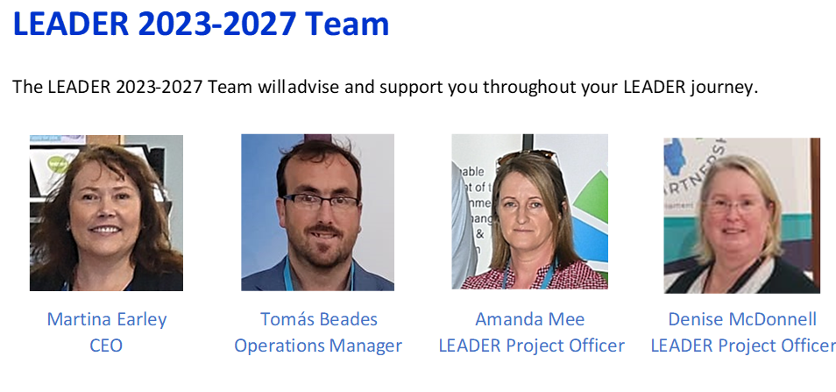
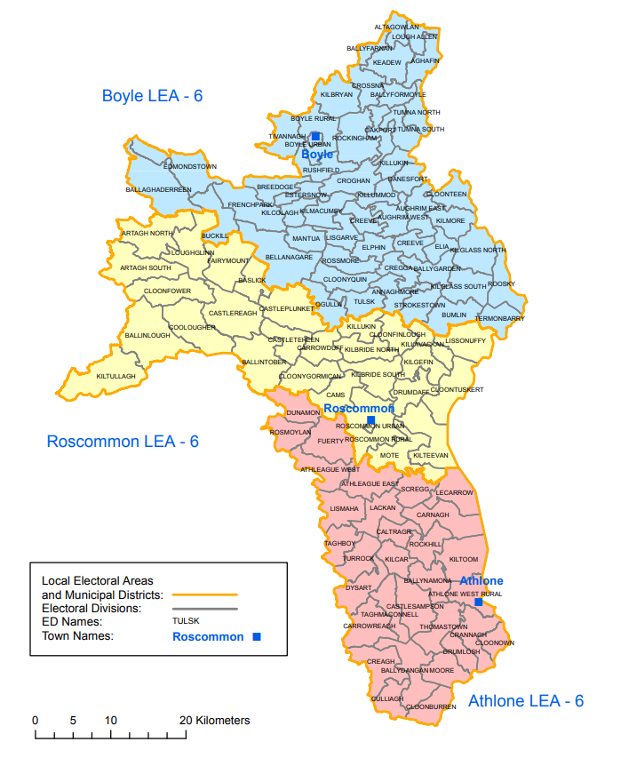
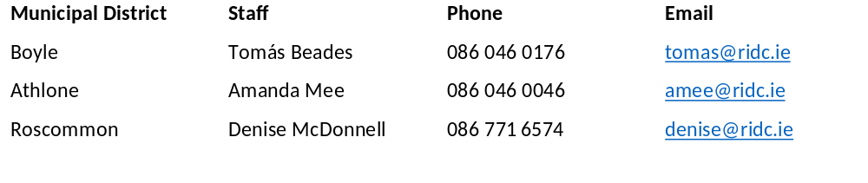

Slide 5
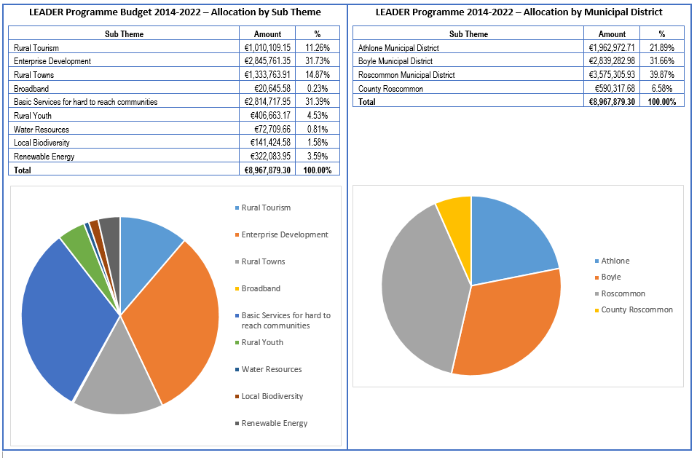

Slide 6
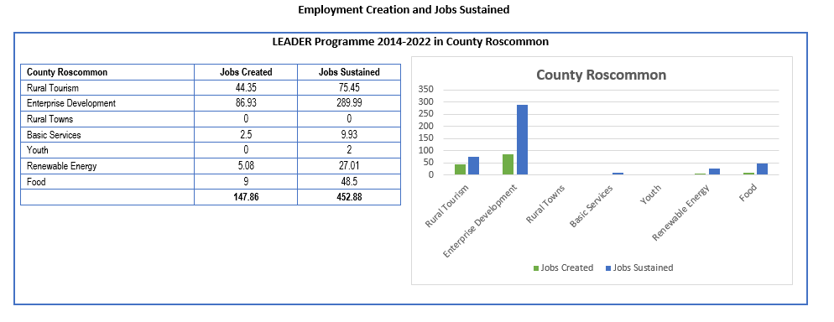

Slide 7
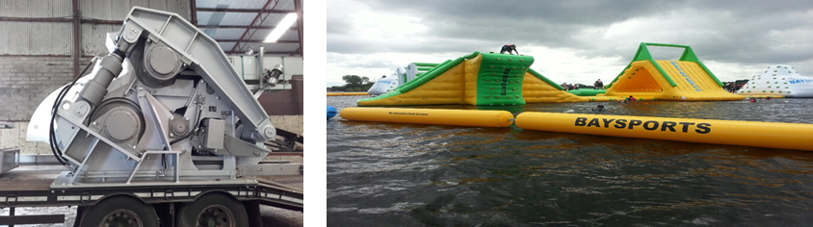

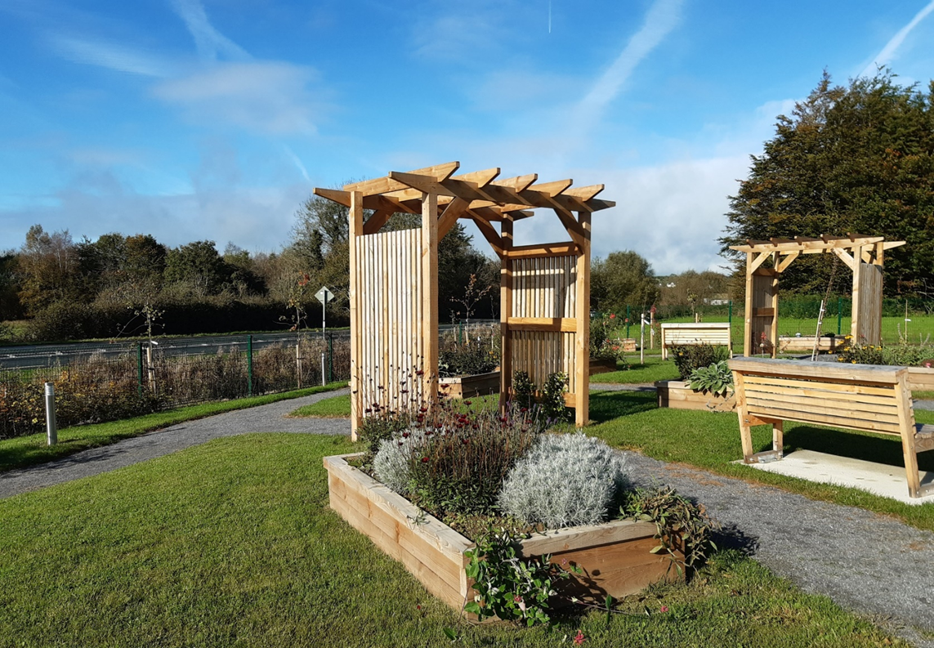
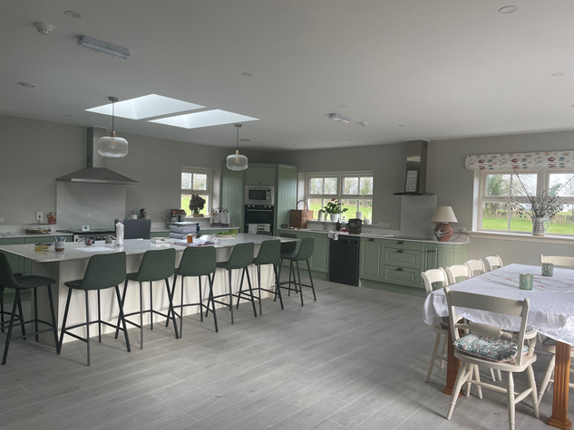
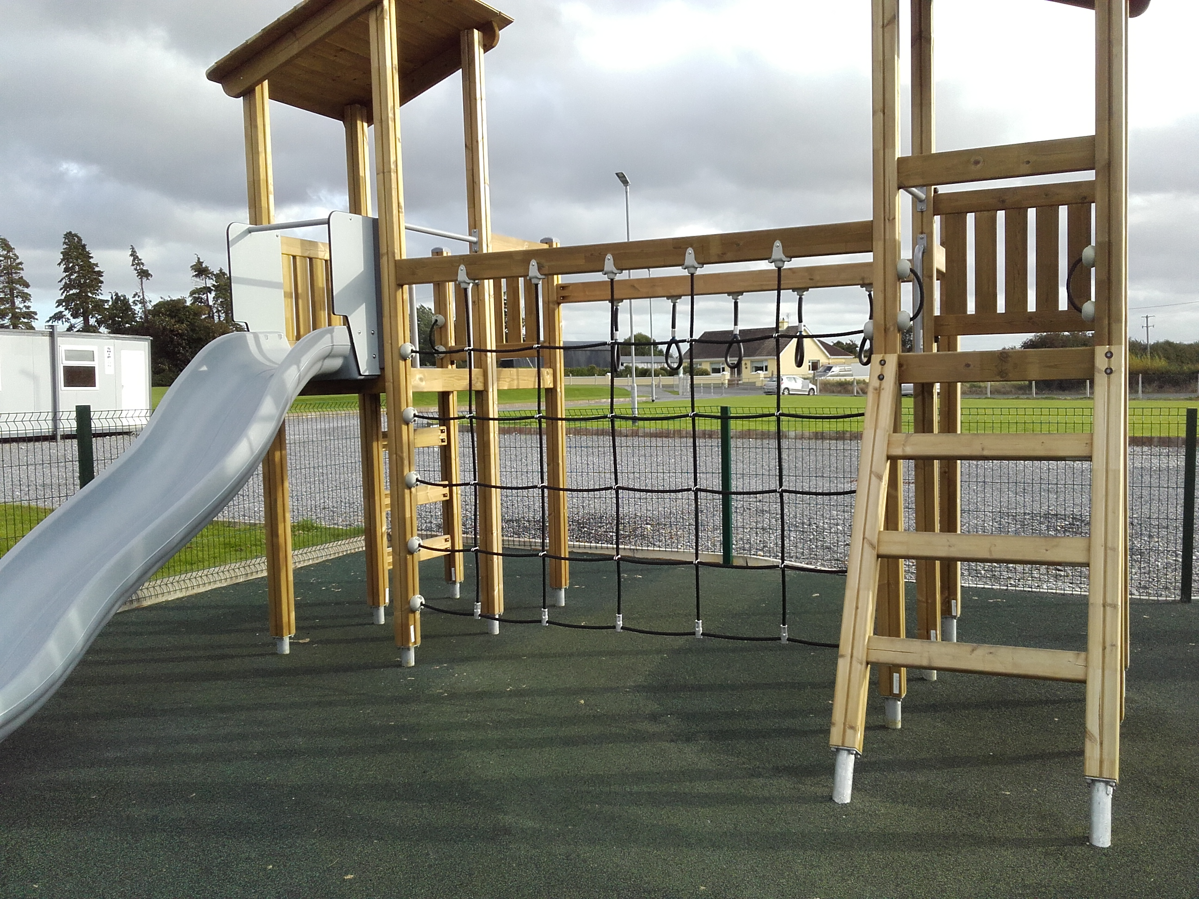
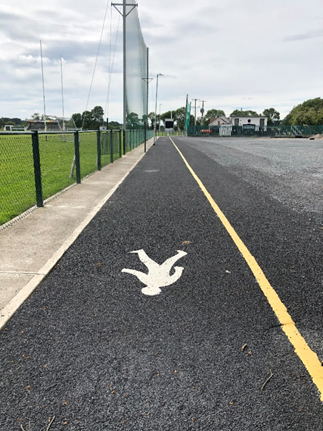
LEADER 2014-22 County Roscommon

Slide 8
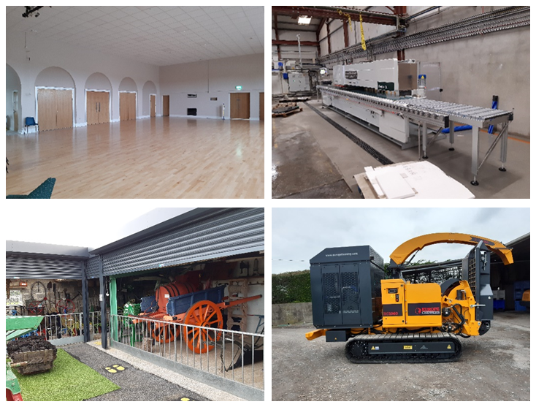
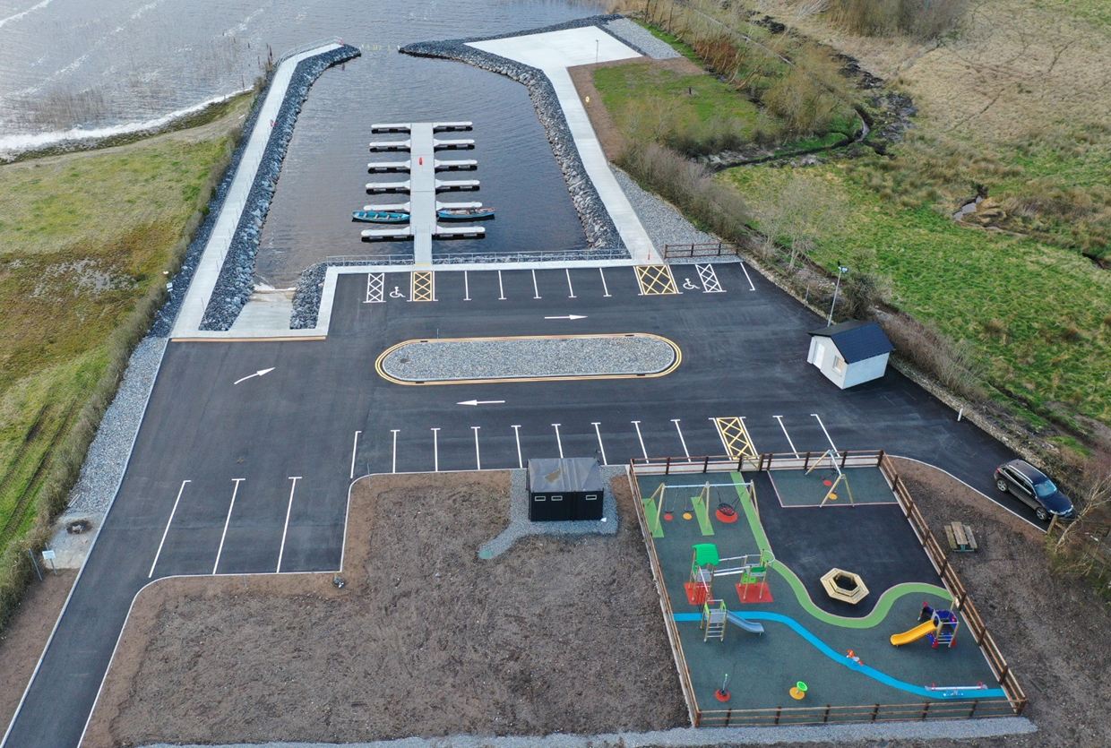

Slide 9
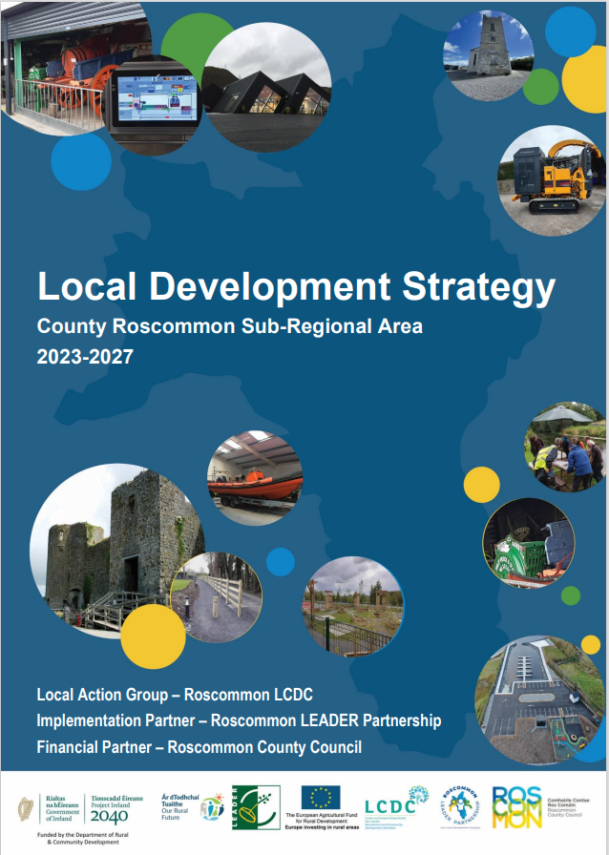
LEADER 2023-2027
A Local Development Strategy was submitted in July 2023 after significant stakeholder consultation by Roscommon LCDC, Roscommon LEADER Partnership and Roscommon County Council
Approved by the Department of Rural and Community Development last year and contracts were signed recently
Summary on our website

Slide 10
Total Budget – LEADER 2023-27 County Roscommon
€ 5,100,000
based on a Community Led Local Development Approach to delivery in
Roscommon

Slide 11
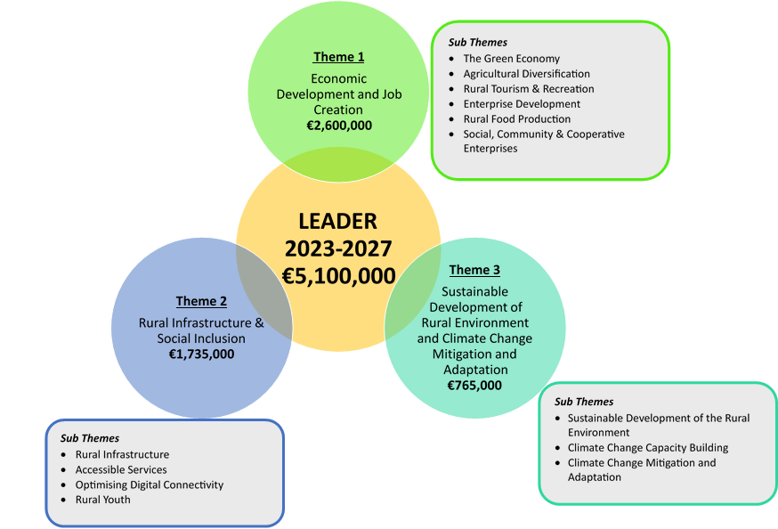

Slide 12
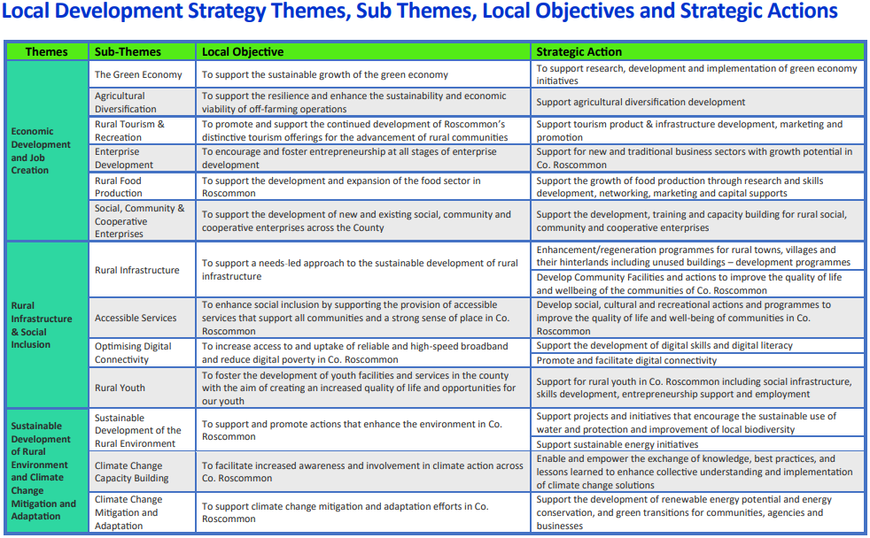

Slide 13

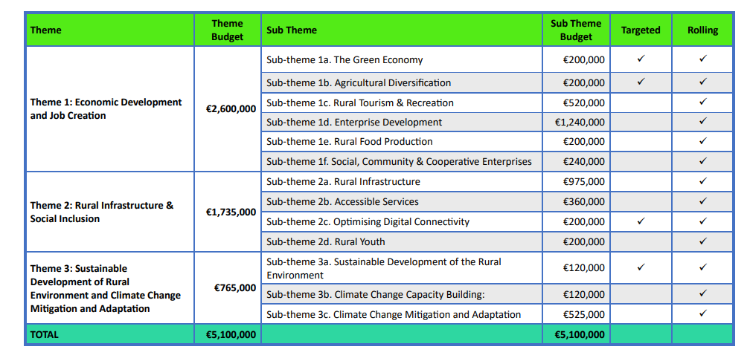
Budget

Slide 14
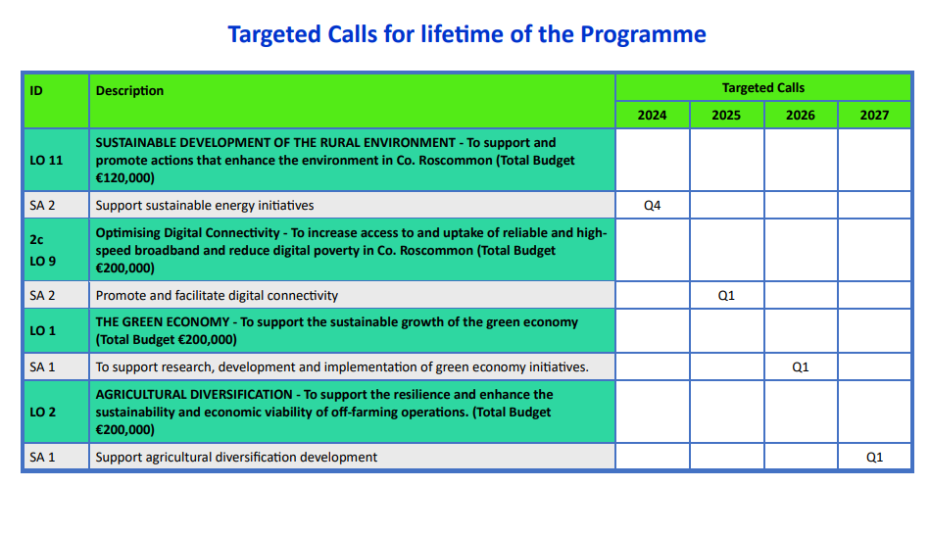

Slide 15

Minimum Funding (Grant) Threshold
Roscommon LCDC will not approve funding of less than €5,000 for any project.

Slide 16

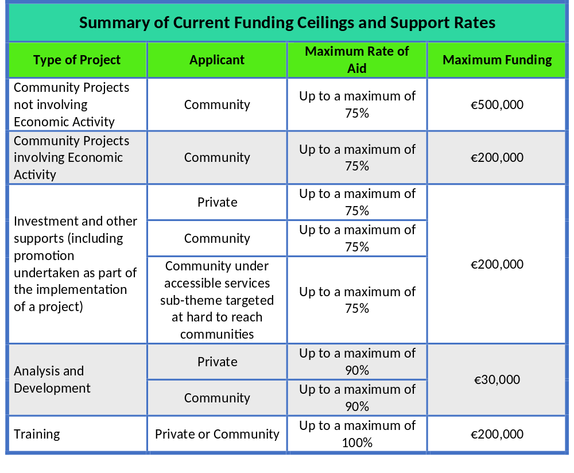
Rates of Aid

Slide 17

Main Eligible Sectors and Activities
Capital
  Building works /refurbishment / upgrade projects
  Purchase of machinery and equipment
Marketing materials
Training (non-mainstream)
Analysis and Development - Feasibility studies, Community plans etc

Slide 18
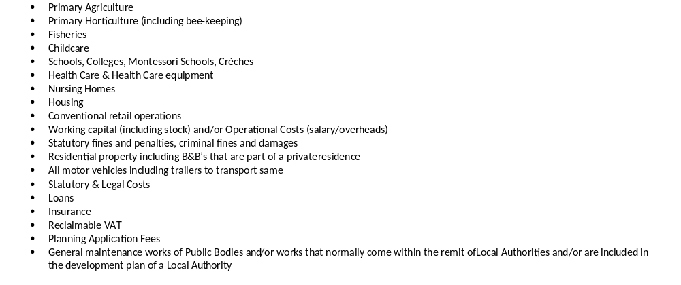

Main Ineligible Sectors and Activities
Note that this list is not exhaustive but captures the main Ineligible Sectors and Actions.

Slide 19
Not a Priority
Playgrounds - Unless it is innovative, (Insurance & Maintenance issue)
Sporting facilities (pitches etc., golf clubs greens, stands, members dressing rooms) – Mainstream Sporting facilities.
Boundary walls unless part of a significant works project (e.g. set a maximum percentage – up to 20%)
Stand–alone car parks part of a significant works project (e.g. set a maximum percentage –up to 20%)
Masseuse, Physical therapy, holistic treatments, alternative therapies, incl. therapies for autistic children/sensory therapies/therapists as they are included under the heading Health Care, including Wellness and Wellbeing.
Purchase of land – it takes PRA too long to process land title transfers
Outdoor Exercise equipment

Slide 20
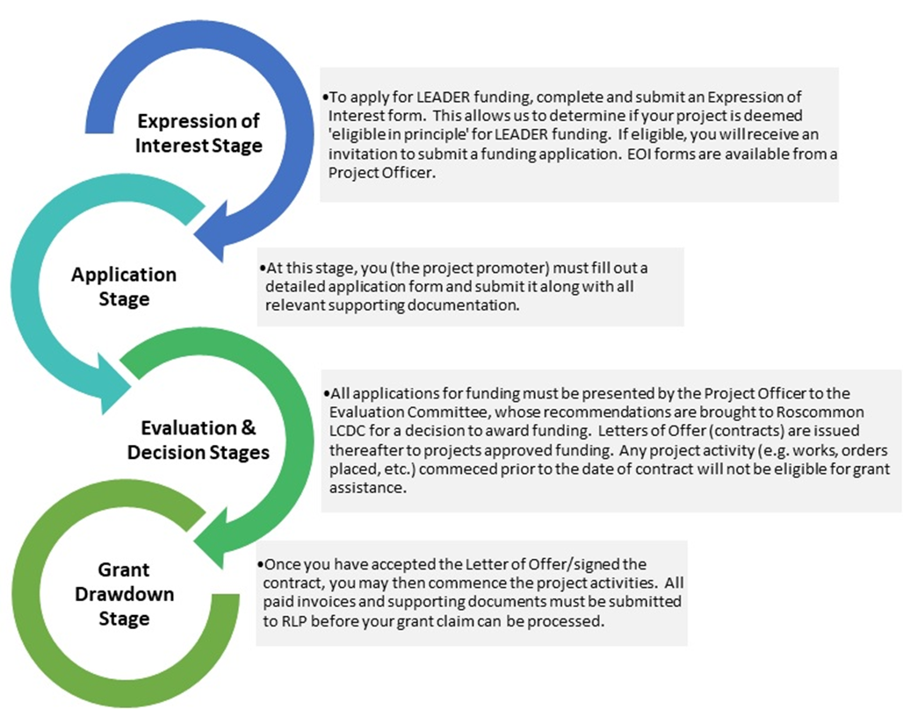
Process

Slide 21
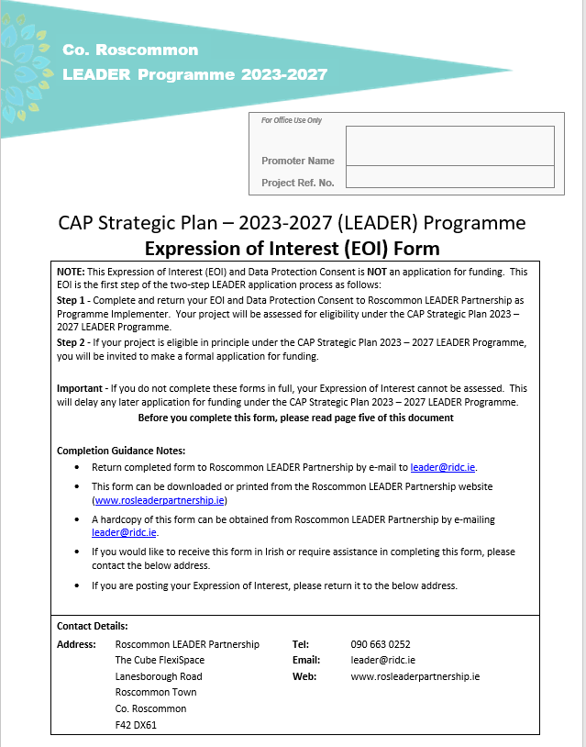

The Expression Of Interest Process
Work with your Development Officer
Detailed EOI Form- Digital Copy
One week from submission of EOI to decision

Slide 22
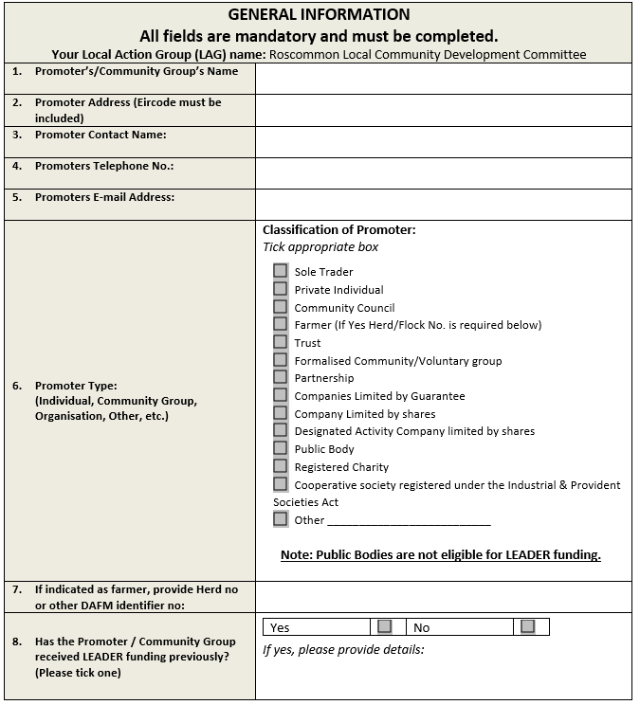
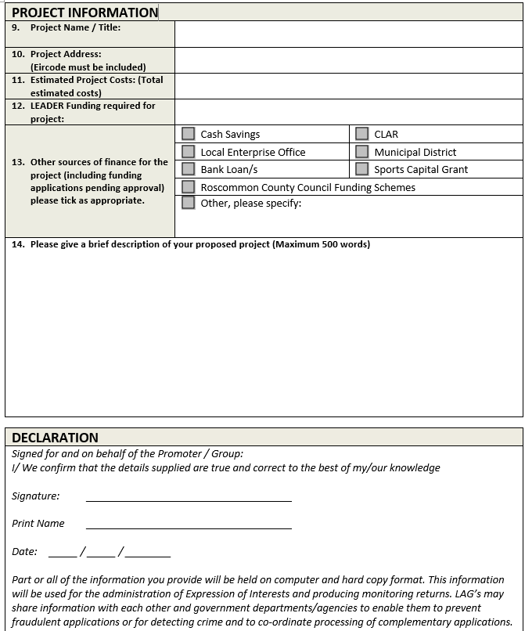

Slide 23

The application process
Requires time and effort
Work with your Development Officer
Detailed Application form-Digital Copy
Supporting Documents
Typically, 3 months from submission of application to signing contract and project start

Slide 24
Supporting Documents
All Projects
3 years accounts
3 months bank statements
Governing Documents
Tax Clearance / VAT status
Full procurement / tendering
Matching Finance and Bridging
Finance Grants received in last 3 years
Capital Works Projects
Proof of ownership / lease Planning permission / exemption
Statutory / Regulatory Approvals e.g. Fire Safety, Building regulations, HSE etc.
Community Projects – Inclusion Strategy
Enterprise Projects Business Plan (5 year)

Slide 25
Displacement
  Displacement occurs where a project funded by public funds impacts negatively on a similar activity elsewhere. LEADER funding cannot be awarded if it will result in an unacceptable level of displacement e.g. closure or loss of another business, service or community facility elsewhere, both locally as well as across Ireland and the EU. Displacement can occur even where the businesses or services are not identical.
Deadweight
  Can you proceed with your project without LEADER funding? If you have the finances available to funding your project yourself, you will not be eligible for LEADER funding.
Matching Funds
  LEADER provides a percentage of funding to projects approved. The remainder of the funding for the project must be provided by the promoter. In the case of private promoters, this must be from a private source (funds on hand, bank loan, etc.); for community projects, cash contributions from public bodies and agencies may be used as matching funds but not grant schemes and programmes operated by public bodies. 5% Rule – promoters must contribute at least 5% of the overall project costs from their own financial reserves (exception – training projects).
State Aid and De Minimis
  Under State Aid and De Minimis Rules, an applicant may receive a maximum of €300,000 in grant aid over a 3 year period where the project/applicant involves economic activity. If you, your business or group/ organisation received public funding in the past 3years, this may deem applications ineligible for LEADER funding.

Slide 26
Bridging Finance
  LEADER funding is paid retrospectively, i.e. if approved LEADER grant aid, a promoter implements their project, pays for all work, equipment, etc. and submits a grant claim to draw down the LEADER grant. Promoters must demonstrate that they have the required bridging finances in place to implement the project. This can be by way of a bank loan, Credit Union loan or social finance loan.
Public Procurement
  LEADER funding is considered public funding, therefore applicants for LEADER funding must obtain appropriate quotes/tenders for the proposed project costs, in line with Public Procurement rules. Guidelines on procurement for LEADER project will be issued to all applicants who submit an eligible Expression of Interest. Final procurement must be submitted at Application Stage.
Planning Permission
  Planning Permission/Exemption from Planning is generally required for all projects involving development of land and/or property. Promoters must ensure that all aspects of the project for which you are seeking LEADER funding are included in the planning permission/exemption from planning application. Documentary evidence confirming that Planning Permission/Exemption from Planning has been granted by Roscommon County Council must be submitted at Application Stage.
Title
  Where a promoter intends to apply for LEADER funding for the development of land or property, you must provide proof of ownership/lease. The following documents are accepted as proof:
A recently certified copy (by solicitor) of the Folio/Stamped Deed of Conveyance and map, showing the promoter as owner;
A long-term lease for property in question (minimum of 10 years remaining at application stage) and map

Slide 27
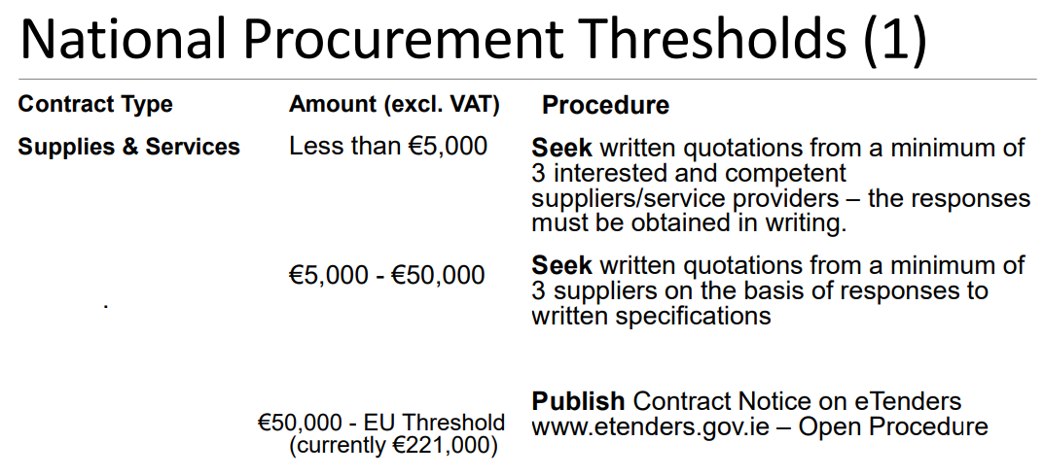
Procurement

Slide 28
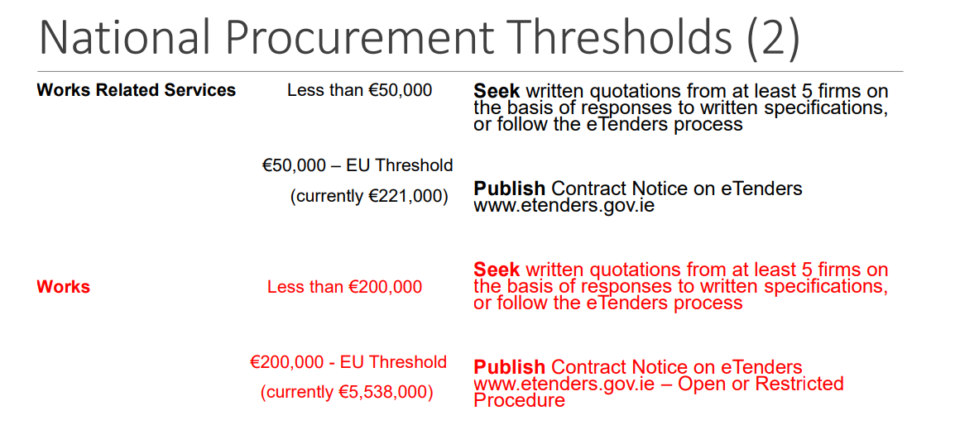
Procurement

Slide 29

The Approval Process
Independent Evaluation Committee (IEC)
Rigorous Check and Audit of project file
Local Action Group (LAG) Approval - Roscommon LCDC
Issue & Signing of Contract
ONLY EXPENDITURE MADE AFTER CONTRACT ISSUE & SIGNING IS ELIGIBLE
GRANT AID PAID IN ARREARS
NO Provisional Approval – Planning and Procurement
Project should continue as funded and be insured for 5 years after final payment

Slide 30
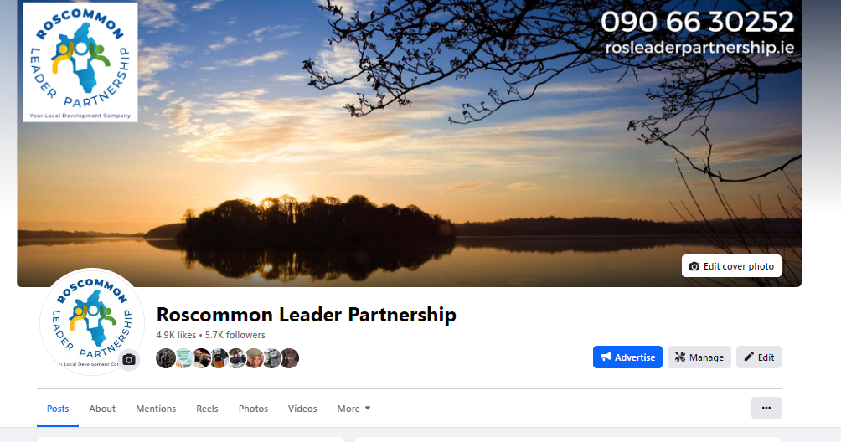

Website
Further Information and Forms (Downloads)
LEADER Expression of Interest Form
LEADER Information Booklet
LEADER Webinar Presentation
Roscommon Local Development Strategy
LEADER Operating Rules
Expression of Interest Form

Slide 31
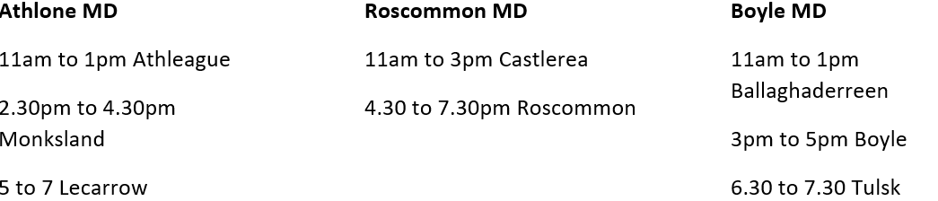
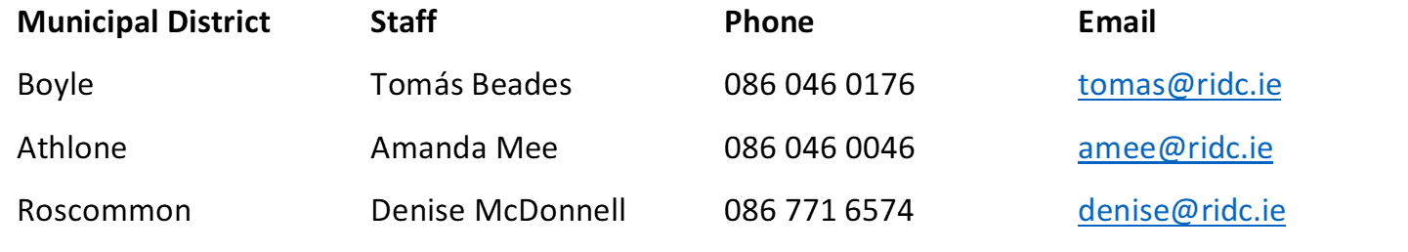
Follow on Clinics Wednesday 29th May
Booking ESSENTIAL

Slide 32

Conclusion
LEADER funding can support your project
Application process requires time
We are here to help and support
Thank you to Roscommon PPN
Thank you for your time.
Any Questions??

